Slide 1
Bankruptcy Forecast
1
the Future of Taiwanese Company bankruptcies:
Prepared and Presented by:
Alejandro Gomez
Jessica Dean
Stacey Boyce
Brook forrester
Becca Stilley
Notes:
Becca

Slide 2
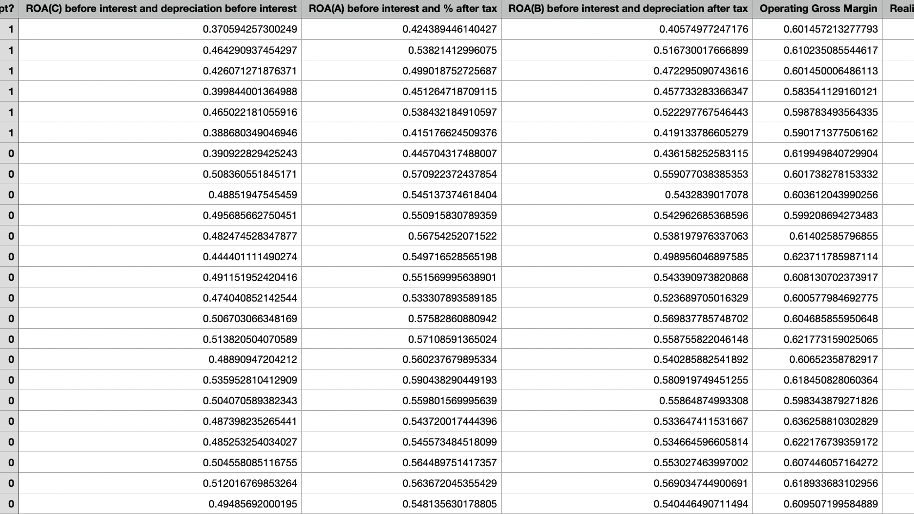
Original Dataset
2
Bankruptcy data from the Taiwan Economic Journal for the years 1999-2009, Stock exchange dataset
Notes:
Jessica

Slide 3
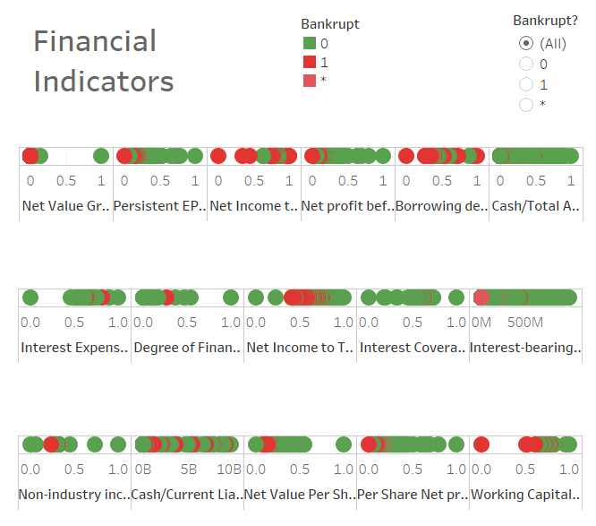
Background on the Dataset
3
The Taiwanese Stocks consist of about 2500 different companies including those that have gone bankrupt between 1999 and 2009
The original dataset had 95 financial indicators
Includes indicators for Bankrupt, In the Process of becoming bankrupt, and Not Bankrupt
Notes:
Becca

Slide 4

What is it, and how does it Happen?
4
Legal process that involves a person or business that is unable to repay their outstanding debts.
All the debtor's assets (property, gifts, land, etc.) are measured and evaluated; the assets may be used to repay a portion of outstanding debt.
Does not necessarily mean complete dissolution of company
Chapter 11- reorganization of assets/company debt
Notes:
Jessica

Slide 5
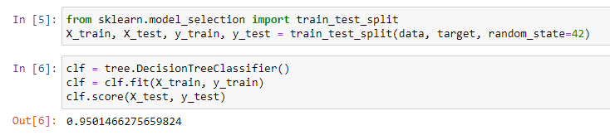
Data Cleaning & Decision Tree Classifier
5
We asked ourselves can we predict using the data to determine if a company is likely to go bankrupt
Dataset was clean and consistent to begin with, in terms of missing data
Our Process:
Used Pandas to read CSV file
Used Sklearn in Jupyter Notebook to test, train, split the data and then used decision tree producing a score of 95%
Notes:
Stacy

Slide 6
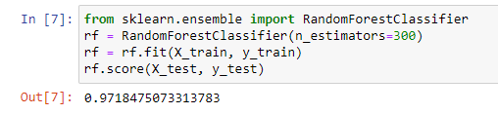
Random Forest Classifier
7
Used Random Forest Classifier and obtained a score of 97.18% after trying with different numbers of estimators
Notes:
Stacy

Slide 7
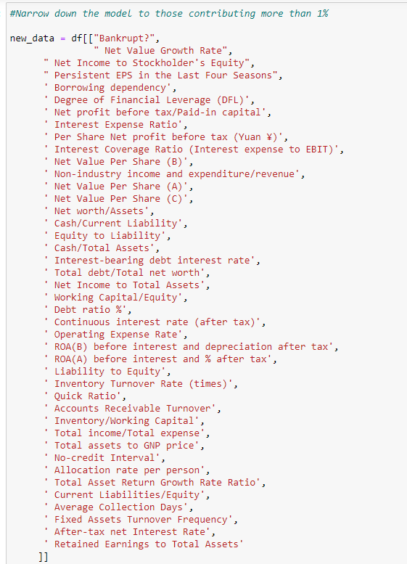
Data revision..
6
There were originally 95 different parameters, so we decided to use feature importance to determine which parameters were relevant
We kept 41 parameters, and removed anything contributing to less than 1% to that importance factor
We then tested the model with the 41 relevant indicators that resulted, and we did not lose much integrity with our data (0.1%)
Notes:
Stacy

Slide 8
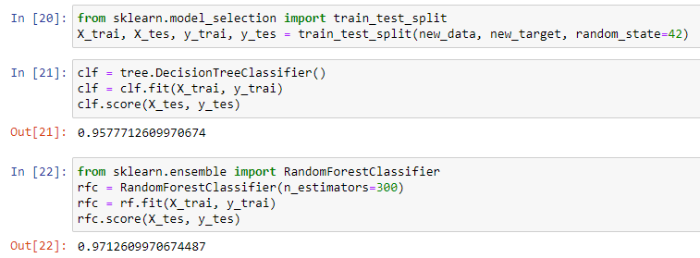
Decreasing Parameters
8
Notes:
Stacy

Slide 9
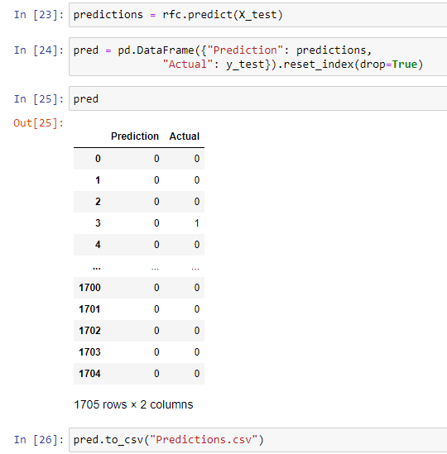
Prediction vs. Actual
9
Ran prediction vs actual in data frame and exported to a csv to double check.
Notes:
Stacy

Slide 10
So, what does the Data look like?
11
We chose to use Tableau to visualize our data.
Tableau is an intuitive tool that allows you to produce multiple visuals quickly.
We realized that the lack of identifiers for the companies in the dataset was problematic because we didn’t have enough information for our axis’ to graph
To troubleshoot this, we used pandas to add the index as a column so that each row (Company) had a unique identifier.
We also changed the 0 or 1 in the “Bankrupt?” column to be text instead of string to make the data more useful in Tableau.
Notes:
Becca

Slide 11

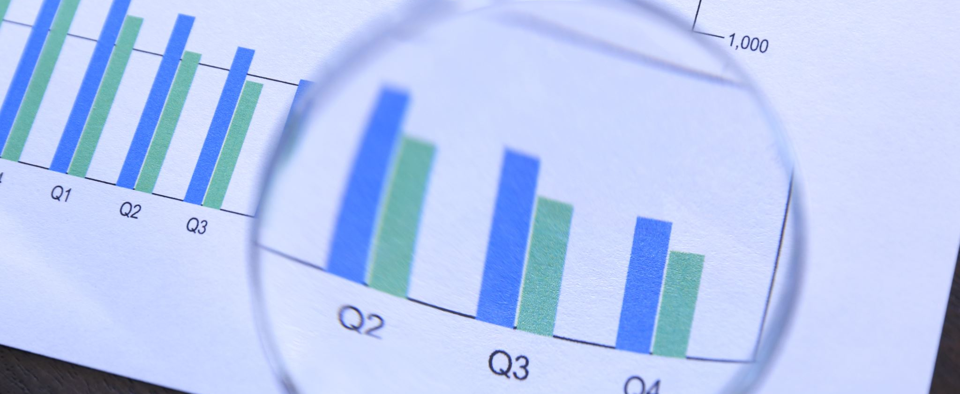
Visualizations
Comparing top prediction ratios for Bankrupt Vs. Non-Bankrupt companies
Notes:
Becca

Slide 12
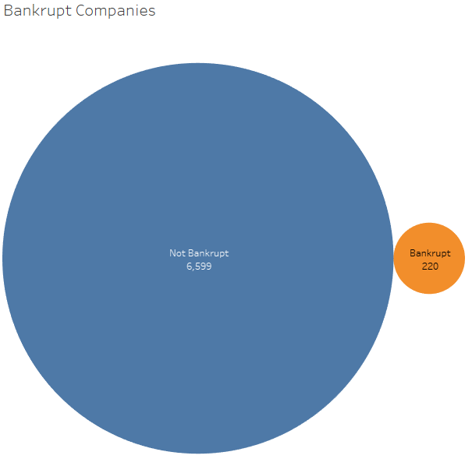
Bankrupt vs. Not Bankrupt 1999-2009
13
Over 10 years, only 3.33% of companies filed for Bankruptcy in Taiwan
Notes:
Brook

Slide 13
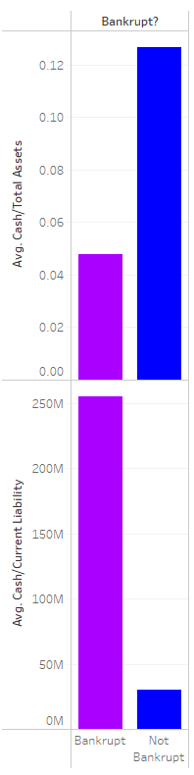
Ratio of Liability vs Total Assets
14
This graph shows what you would expect when you compare the average ratio for cash/assets and cash/ liabilities for bankrupt and non-bankrupt companies.
Assets are anything of value that can be converted to cash, in the data the non-bankrupt companies have an average ratio of .12664 and bankrupt companies .04774.
Liabilities is something a company owes; the non bankrupt companies have an average liability of $30M and bankrupt companies is $256M
Notes:
Brook

Slide 14
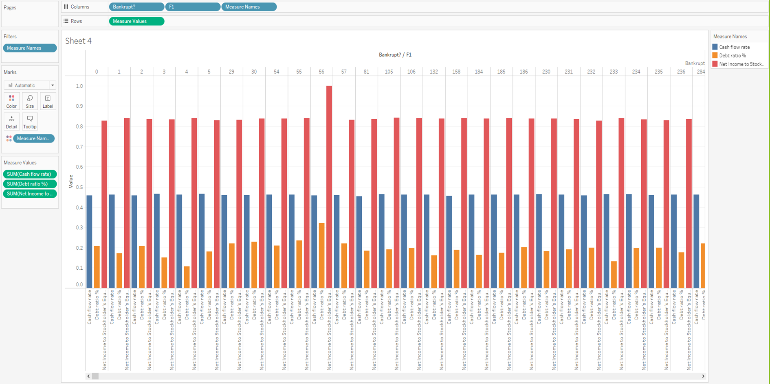
It was a challenge to put together visuals to analyze individual factors by each company as we had too many companies and we wanted to show more than one ratio.
15

Slide 15
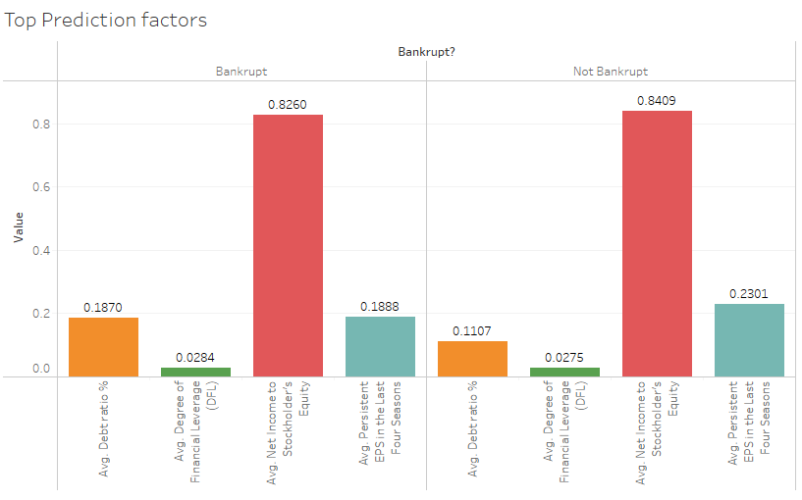
Top Predictors
16
This graph is a modified version of the previous graph.
We removed the individual company from the columns and looked at 4 of the top prediction factors identified through machine learning.
Issues : some indicators were ratios while others were dollars, so the ratios did not appear since they were decimals.
The four factors we used did not have a drastic variance like we saw with the liability and asset when we compared them for the bankrupt and non-bankrupt companies.

Slide 16
What We Learned
17
It is difficult to predict what the future will look like for Taiwanese companies using our dataset
Aside from having setbacks with the data set, we were still able to use the data for other observations
Important factors that contribute to a company either failing or succeeding
Notes:
Jessica

Slide 17
Roadblocks
18
The dataset did not detail individual company names which made it more difficult for us to generate detailed visuals in Tableau
The data was combined for all 10 years, rather than listing out each company per year.
Our dataset was specific to Taiwan, which was difficult to find supplemental data to compare.
We looked for other datasets, but there were no other viable sources
With the time frame that we had, it was not effective for us to reach out to actual companies to request data from them
Notes:
Jessica

Slide 18
Visit our website @
19
Notes:
Alejandro

Slide 19

References
https://www.kaggle.com/fedesoriano/company-bankruptcy-prediction
https://public.tableau.com/app/profile/alejandro.gomez5182/viz/Bankrupcy/Dashboard1
Notes:
Becca

